Slide 1
LANE DETECTION
BY:-
SHUBHKARMAN SINGH (102103170)
DIVREET KAUR (102103167)
ABHISHEK BENIWAL (102103159)
Using Python

Slide 2
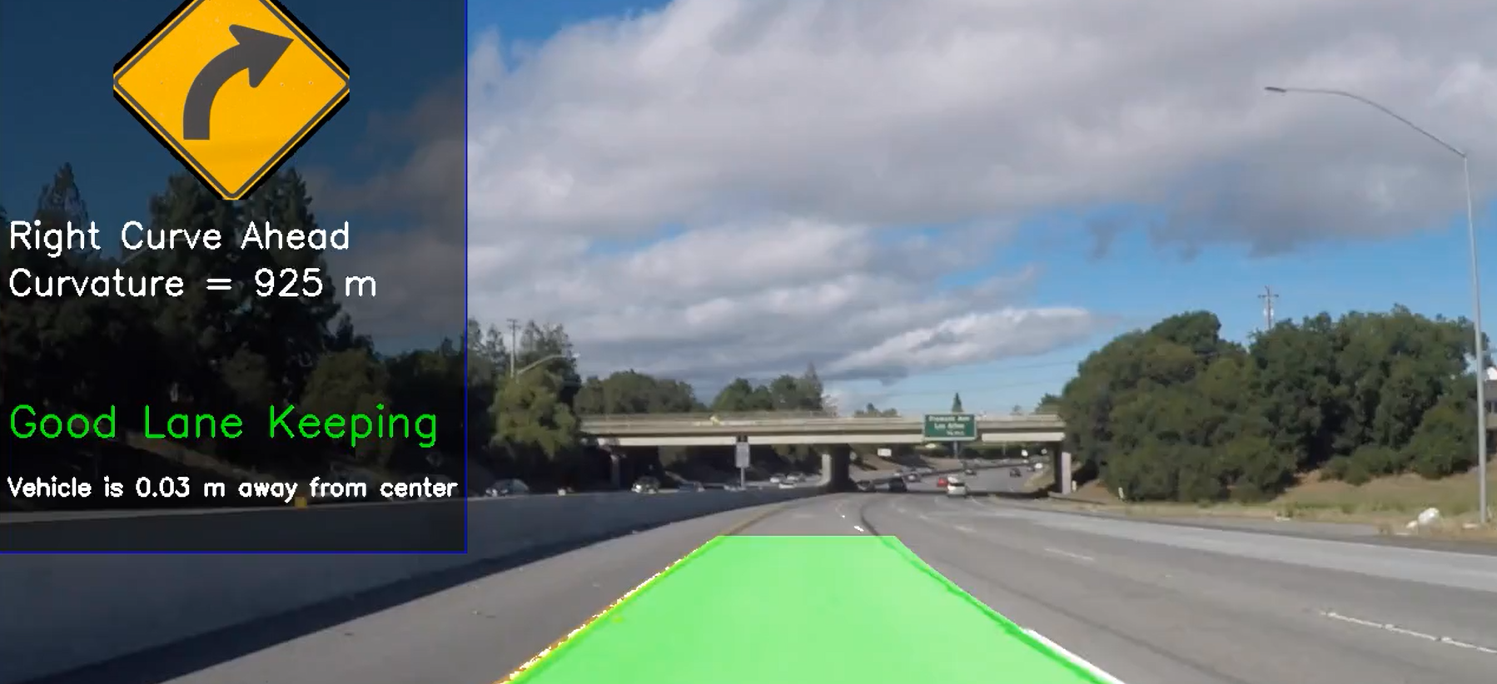

Slide 3
INTRODUCTION
Lane detection is an important component of autonomous vehicles and ADAS, as it enables the vehicles to stay within their designated lanes while driving on roads.
Importance of lane detection in self-driving cars and Advanced Driver-Assistance Systems (ADAS) is that it helps to improve the safety and accuracy of autonomous vehicles, and is crucial for the successful implementation of these technologies.
This presentation will provide an overview of lane detection using Python, including the image processing techniques used and how they are applied in lane detection, as well as the different approaches to lane detection.

Slide 4
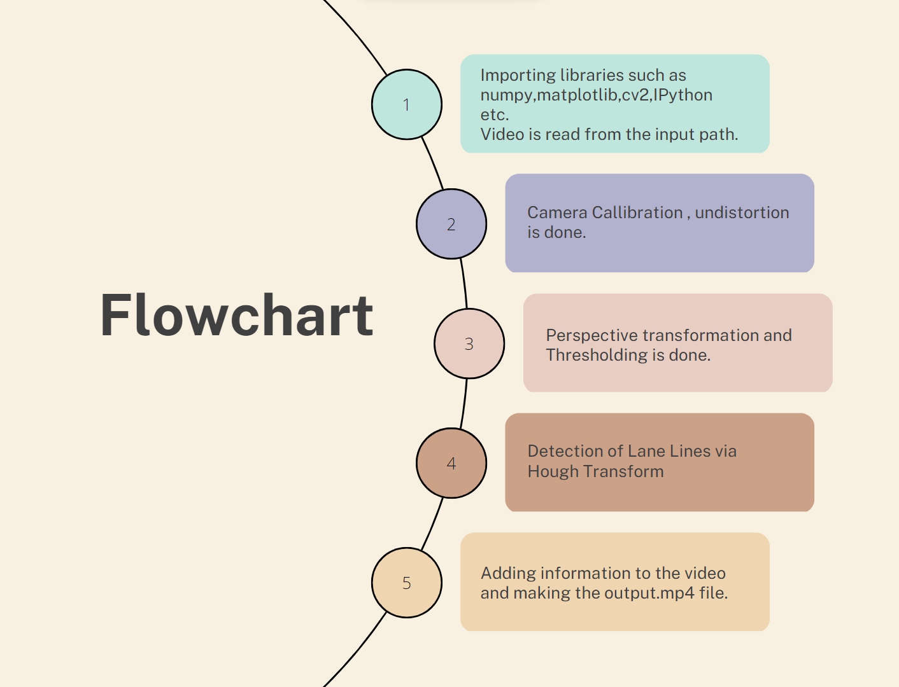

Slide 5
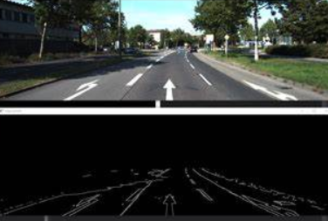
IMAGE PROCESSING BASICS
Image processing techniques are used to enhance the images captured by cameras in autonomous vehicles, and they play a critical role in detecting lanes on the road. The basic techniques that are commonly used include thresholding, blurring, edge detection, and more.
These image processing techniques are applied to the
captured images to identify the edges of the lanes,
which are then used to determine the location and
boundaries of the lanes.

Slide 6
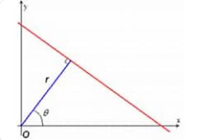
HOUGH TRANSFORM
The Hough Transform algorithm is a popular technique used in image processing for detecting lines and shapes. It works by identifying patterns in the image that correspond to lines, and then using these patterns to identify the location and orientation of the lines.
In lane detection, the Hough Transform algorithm
is used to identify the lines that correspond to the
lanes on the road, by detecting the edges of the lanes
in the image and then transforming these edges into
lines using the Hough Transform.

Slide 7
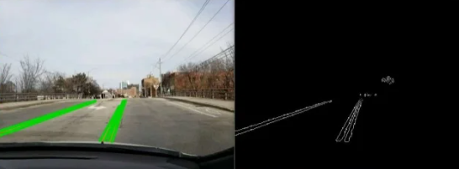
CANNY EDGE DETECTION
The Canny Edge Detection algorithm is another popular technique used in image processing for detecting edges in an image. It works by identifying the areas of the image with the highest gradient, which are usually the edges of objects in the image.
In lane detection, the Canny Edge Detection algorithm is used to detect the edges of the lanes on the road, which are then used to determine the location and boundaries of the lanes.

Slide 8
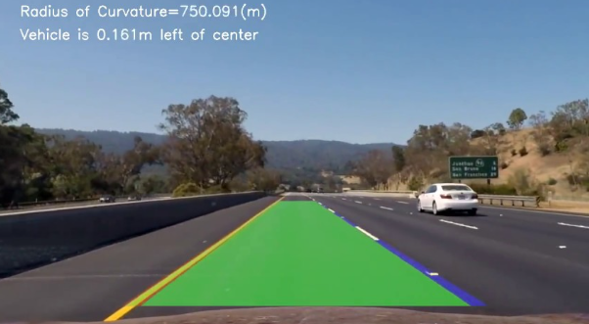
LANE DETECTION PIPELINE
The lane detection pipeline is a series of steps that are used to identify and locate the lanes on the road. These steps include capturing the image, applying image processing techniques, detecting the edges of the lanes, and transforming the edges into lines using the Hough Transform.
The steps involved in the lane detection
pipeline can vary depending on the
specific approach used, but typically
involve a combination of image processing
techniques, edge detection, and Hough
Transform.

Slide 9
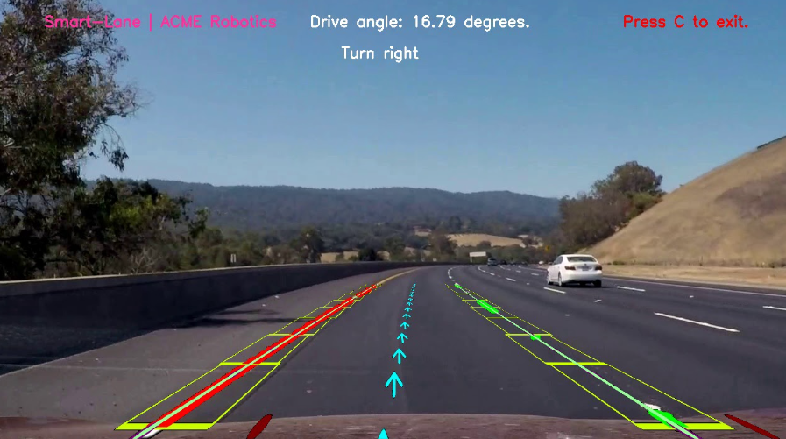
LANE DETECTION USING OPEN CV
OpenCV is a popular library used for computer vision and image processing.
In lane detection, OpenCV can be
used to apply the necessary image
processing techniques, detect edges,
and perform the Hough Transform to
detect the lanes on the road.

Slide 10
CONCLUSION
The presentation covered the basics of image processing and the various techniques used for lane detection in Python, including the Hough transform and Canny edge detection. It also included a demonstration of lane detection using OpenCV.
Accurate and reliable lane detection is critical for the safe and effective operation of self-driving cars and ADAS. It helps the vehicle to stay in its lane, avoid collisions, and navigate safely on the road.

Slide 11
FUTURE SCOPE
Lane detection is an active research area, and there is scope for improving the accuracy and efficiency of existing techniques. Future developments in this field will help to make self-driving cars and ADAS even safer and more efficient.
Next Slide Shows the Video Demonstration of our project:-

Slide 12
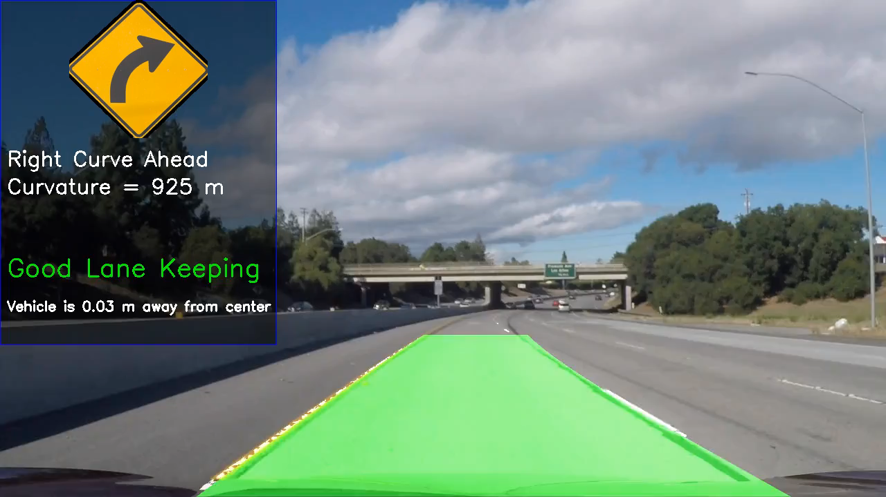

Slide 13


